Slide 1
Identification of Disinformation types in LLMs

Slide 2
Problem Statement
RQ1: How efficiently different LLMs label the category of disinformation over simple run and when structured prompts are used?
RQ2: Predictions of SLMs v/s LLMs. Can SLMs outperform LLMs with appropriate dataset ?
RQ3: Which is the most deceptive disinformation category and reasons for the same?

Slide 3
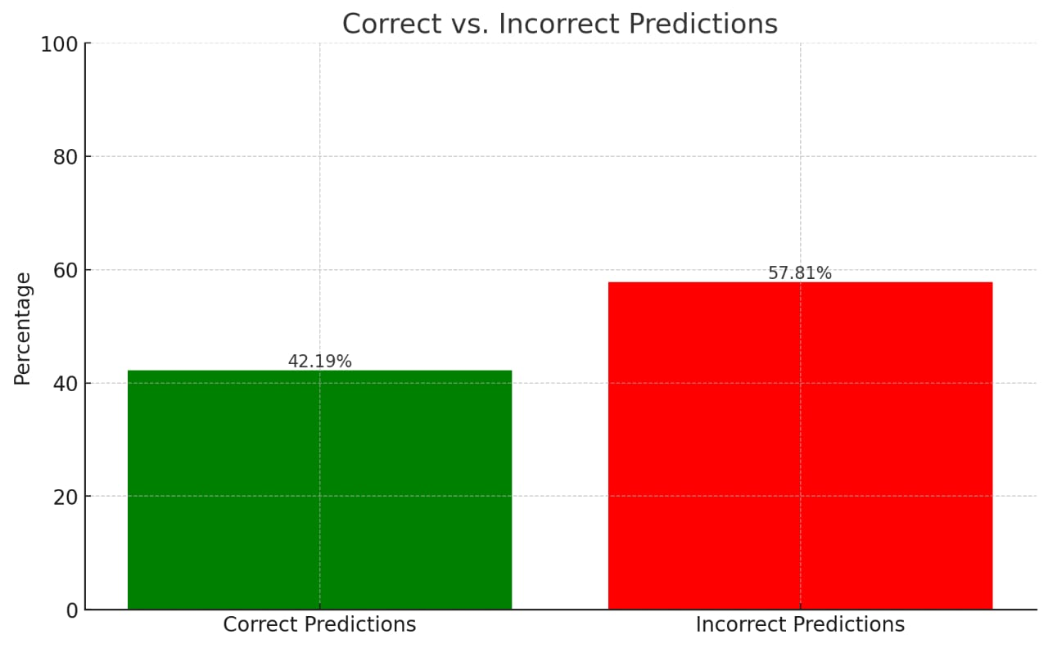
Findings
RoBERTa, a SLM model was loaded with a dataset consisting of 318 rows.
The predictions made by RoBerTa was compared with the actual labelings. As of now only the following categories or labels were considered, true content, satire, misleading content and imposter content.
Surprisingly, the accuracy for right predictions was nearly 40% without initial training.

Slide 4
Challenges
Fakeddit Dataset had only titles and labels of the categories of disinformation but not the description.
Considering Fakeddit Dataset to be huge, A new dataset was created with 318 rows. But for the two categories, Manipulated and false connection only image were found not textual data.

Slide 5
Further Work
Text Dataset related to False and Manipulated content is to be found and added to the Dataset. If not found images shall also be considered for categorization.
As of now direct run is made without the use of the prompts. A general prompt to be finalised which can yield better accuracy rates compared to direct run and the comparisons of them are to be presented.
Attempt to train the SLMs with a bigger dataset is to be made for comparison purpose.
Once the prompt is finalised, it is to be tested on the LLM APIs too.

Slide 6
Thank you

